Slide 1
Basics of NLP (Natural Language Processing)
Prof. Yong Won SEO, Ph.D.
College of Business and Economics
Chung-Ang University

Slide 2
NLP (Natural Language Processing)
The technology used to aid computers to understand the human’s natural language
To program computers to process and analyze large amounts of natural language data
Some of famous applications include*:
Language translation applications such as Google Translate
Word Processors such as Microsoft Word and Grammarly that employ NLP to check grammatical accuracy of texts.
Interactive Voice Response (IVR) applications used in call centers to respond to certain users’ requests.
Personal assistant applications such as OK Google, Siri, Cortana, and Alexa.
* https://becominghuman.ai/a-simple-introduction-to-natural-language-processing-ea66a1747b32

Slide 3
Approaches
Rule-based approach
Apply grammatical rules, specified by human
No learning data required, little flexibility
Statistical approach
Popularized since the "statistical revolution" in the late 1980s and mid-1990s
Using statistical inference, automatically learn rules through the analysis of large corpora
HMM, CRF
Deep learning approach
Uses deep learning NN to learn rules through the analysis of large corpora
RNN, LSTM

Slide 4
Basic tasks
Syntax
Stemming
The process of reducing inflected (or sometimes derived) words to their root form. (e.g. "close" will be the root for "closed", "closing", "close", "closer" etc.)
Part-of-speech tagging
Given a sentence, determine the part of speech (POS) for each word
Parsing
Determine the parse tree (grammatical analysis) of a given sentence
Sentence breaking (a.k.a. sentence boundary disambiguation)
Given a chunk of text, find the sentence boundaries
Word segmentation
Separate a chunk of continuous text into separate words
…

Slide 5
Basic tasks (cont)
Semantics
Lexical semantics
Capturing the computational meaning of individual words in context
Named entity recognition (NER)
Given a stream of text, determine which items in the text map to proper names, such as people or places, and what the type of each such name is (e.g. person, location, organization)
Natural language generation
Convert information from computer databases or semantic intents into readable human language
Sentiment analysis (see also multimodal sentiment analysis)
Extract subjective information usually from a set of documents, often using online reviews to determine "polarity" about specific objects
Topic segmentation and recognition
Given a chunk of text, separate it into segments each of which is devoted to a topic, and identify the topic of the segment
…

Slide 6


Slide 7
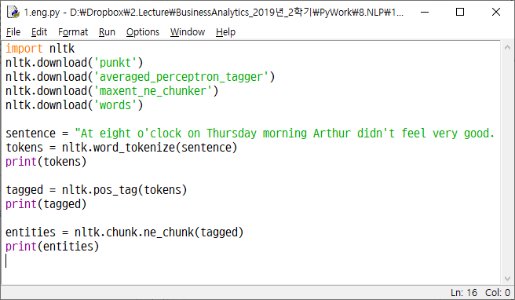
POS tagging and NER

Slide 8
POS tags of NLTK
CC coordinating conjunction
CD cardinal digit
DT determiner
EX existential there (like: “there exists”)
FW foreign word
IN preposition/subordinating conjunction
JJ adjective ‘big’
JJR adjective, comparative ‘bigger’
JJS adjective, superlative ‘biggest’
LS list marker 1)
MD modal could, will
NN noun, singular ‘desk’
NNS noun plural ‘desks’
NNP proper noun, singular ‘Harrison’
NNPS proper noun, plural ‘Americans’
PDT predeterminer ‘all the kids’
POS possessive ending parent’s
PRP personal pronoun I, he, she
PRP$ possessive pronoun my, his, hers
RB adverb very, silently,
RBR adverb, comparative better
RBS adverb, superlative best
RP particle give up
TO, to go ‘to’ the store.
UH interjection, errrrrrrrm
VB verb, base form take
VBD verb, past tense took
VBG verb, gerund/present participle taking
VBN verb, past participle taken
VBP verb, sing. present, non-3d take
VBZ verb, 3rd person sing. present takes
WDT wh-determiner which
WP wh-pronoun who, what
WP$ possessive wh-pronoun whose
WRB wh-abverb where, when

Slide 9
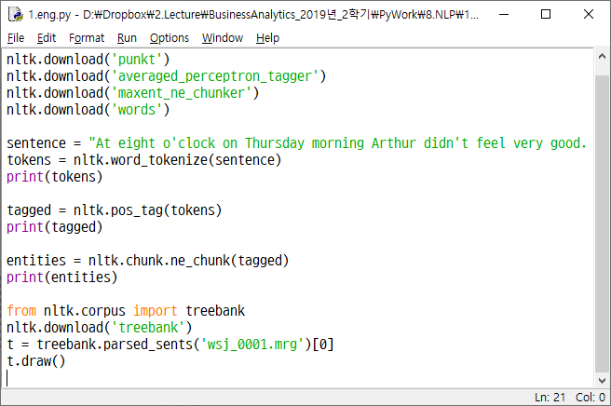
Sentence structure analysis

Slide 10
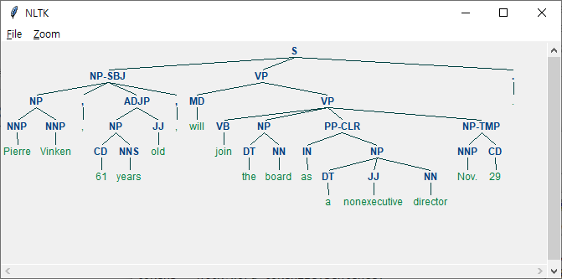

Slide 11
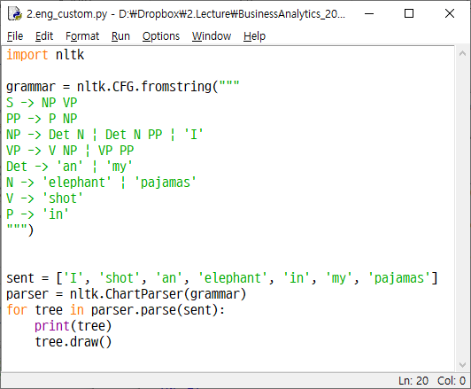
Custom grammar

Slide 12
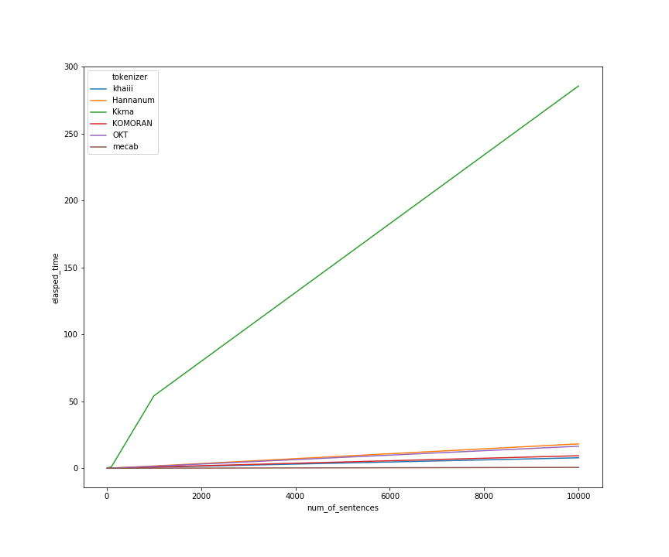
POS tagging for Korean
Several POS taggers
Kkma, Komoran Hannanum, Twitter, Mecab, Khaiii
konlpy package

Slide 13
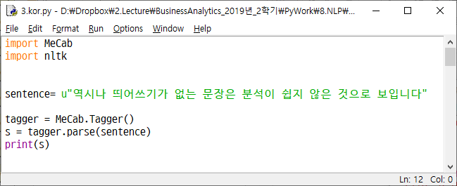

Slide 14
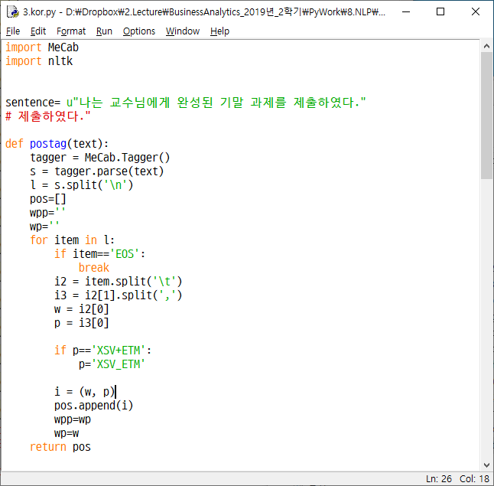

Slide 15
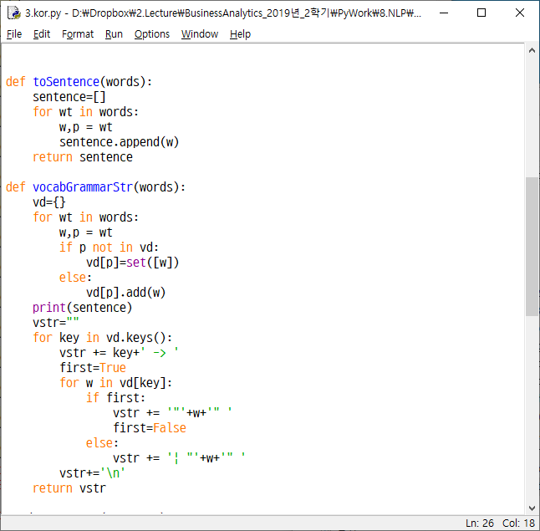

Slide 16
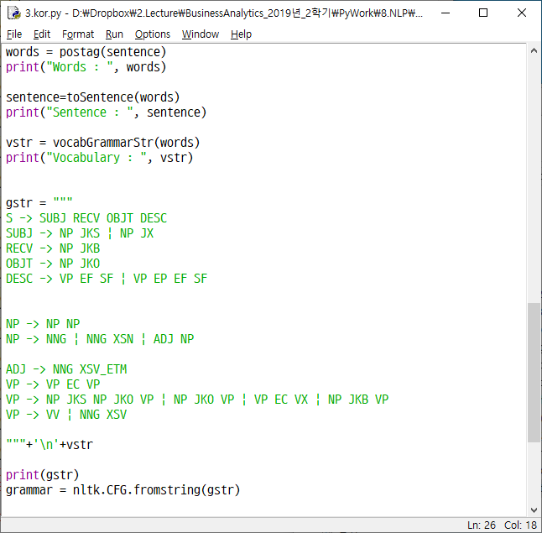

Slide 17
